Slide 1
PRESENTATION BY NANTEZA DOREEN
Question: Analyze the relationship between conservation and sustainable development, showing how conservation contributes to long term development goals

Slide 2
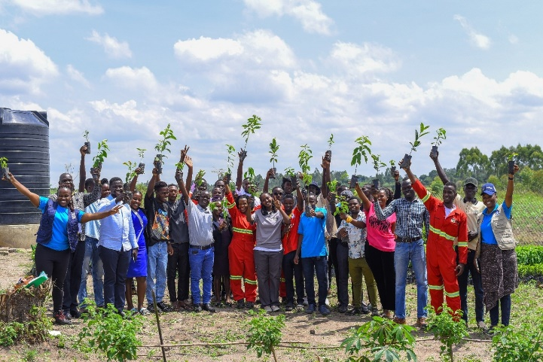
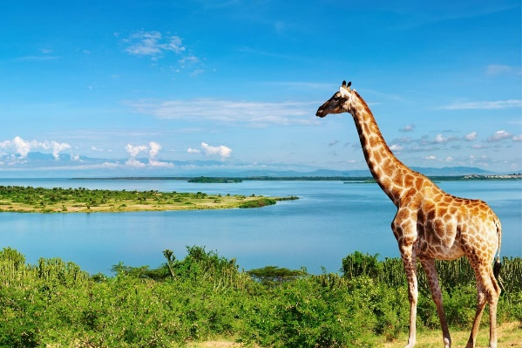
Introduction
Conservation and sustainable development are closely related concepts that aim to ensure that natural resources are used responsibly while meeting present human needs without compromising the ability of future generations to meet their own needs.
Conservation refers to the protection, preservation, management, and restoration of natural resources and ecosystems to ensure their long-term availability. It involves practices such as wildlife protection, forest management, soil conservation, and water resource management
Examples of conservation activities include:
Protecting forests and wetlands
Wildlife conservation
Soil erosion control
Sustainable use of water resources

Slide 3
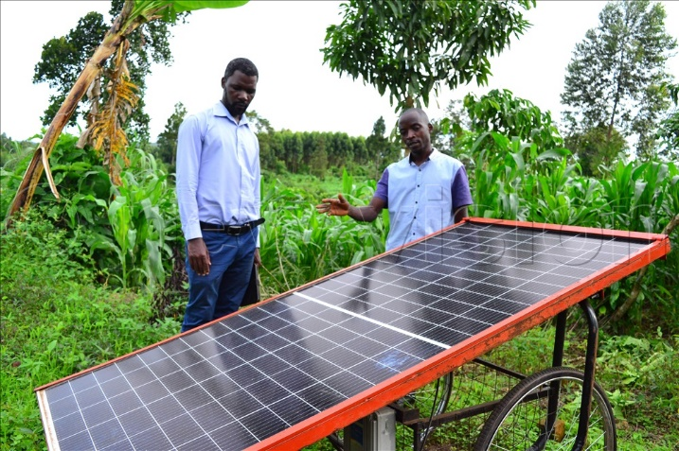
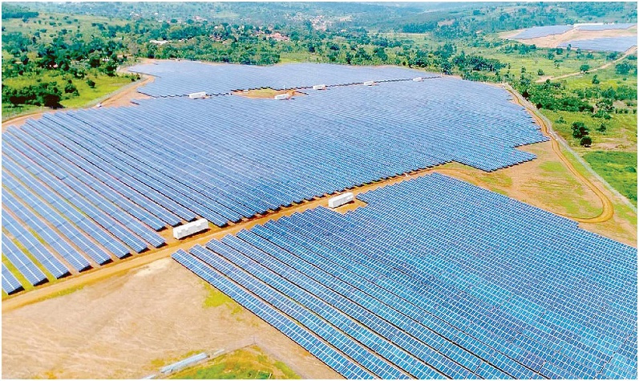
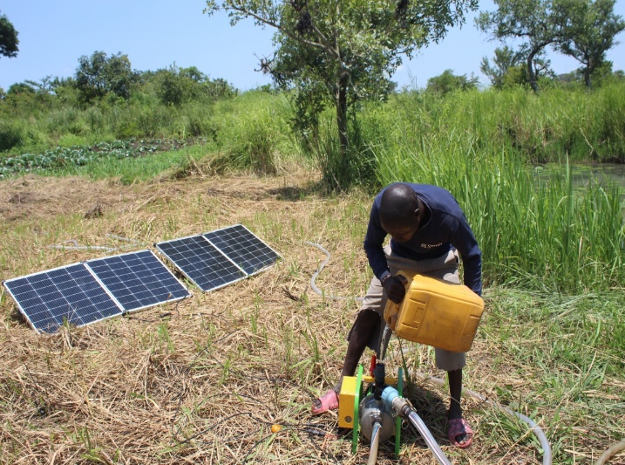
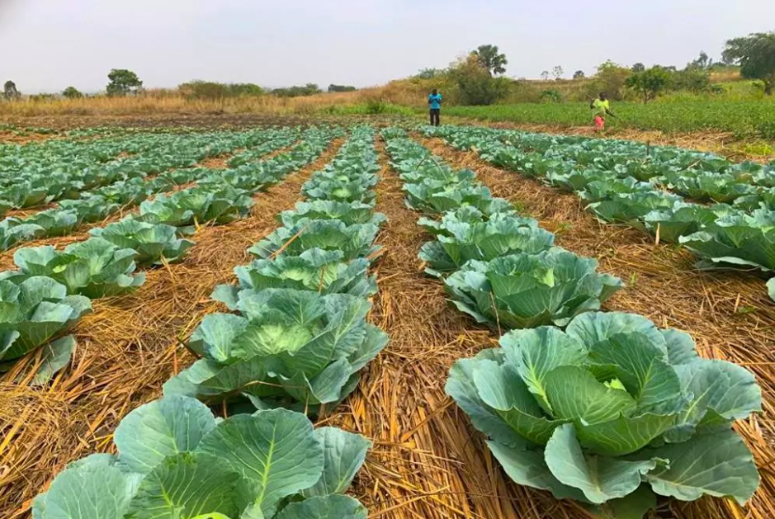
Sustainable Development
Sustainable development refers to development that meets the needs of the present without compromising the ability of future generations to meet their needs. It integrates three key pillars:
Environmental sustainability – protecting natural resources
Economic sustainability – promoting economic growth and employment
Social sustainability – improving people's quality of life.
Solar-powered irrigation and climate-smart agriculture in Uganda illustrating sustainable development through renewable energy, food security, and environmental conservation

Slide 4
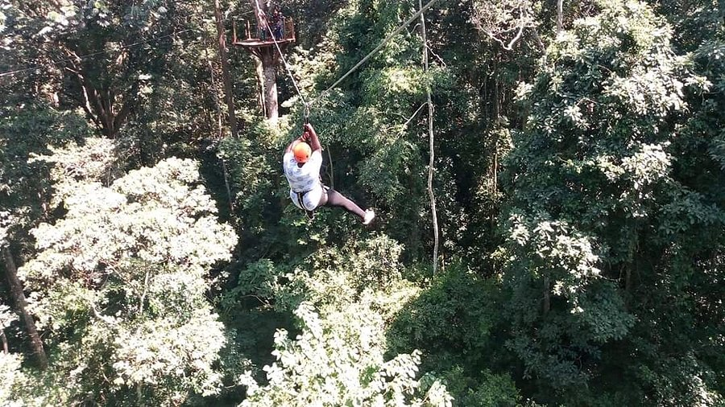
Relationship Between Conservation and Sustainable Development
Conservation Protects Natural Resources for Future Use: Conservation ensures that natural resources such as forests, wildlife, water, and minerals are not depleted. For example, the protection of forests in Mabira Central Forest Reserve helps maintain biodiversity and supports eco-tourism, research, and sustainable harvesting of forest products like medicinal plants and honey.
This contributes to economic development
while protecting the environment

Slide 5
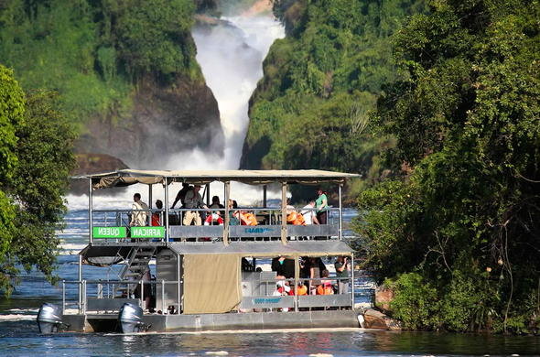
Conservation Supports Economic Development
Conserved natural areas attract tourism, which generates income, employment, and foreign exchange for a country.
For example; Wildlife conservation in Queen Elizabeth National Park and Murchison Falls National Park supports Uganda’s tourism industry. Tourists visit these parks for wildlife viewing, which creates jobs for tour guides, park rangers, hotel workers, and local communities.

Slide 6
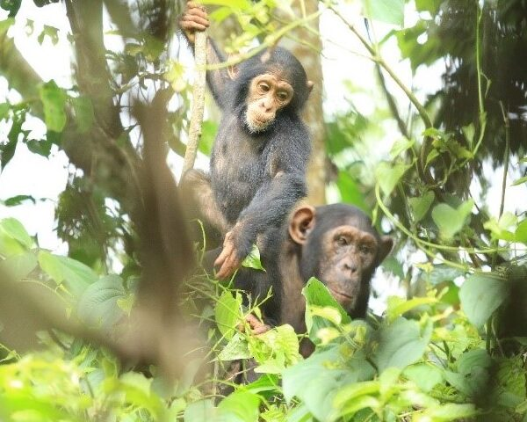
Conservation Protects Biodiversity for Sustainable Development
Biodiversity provides resources such as food, medicine, and raw materials that are important for human survival and development. For Example: The conservation of mountain gorillas in Bwindi Impenetrable National Park attracts international tourists, generating revenue for the country and supporting community development projects.

Slide 7
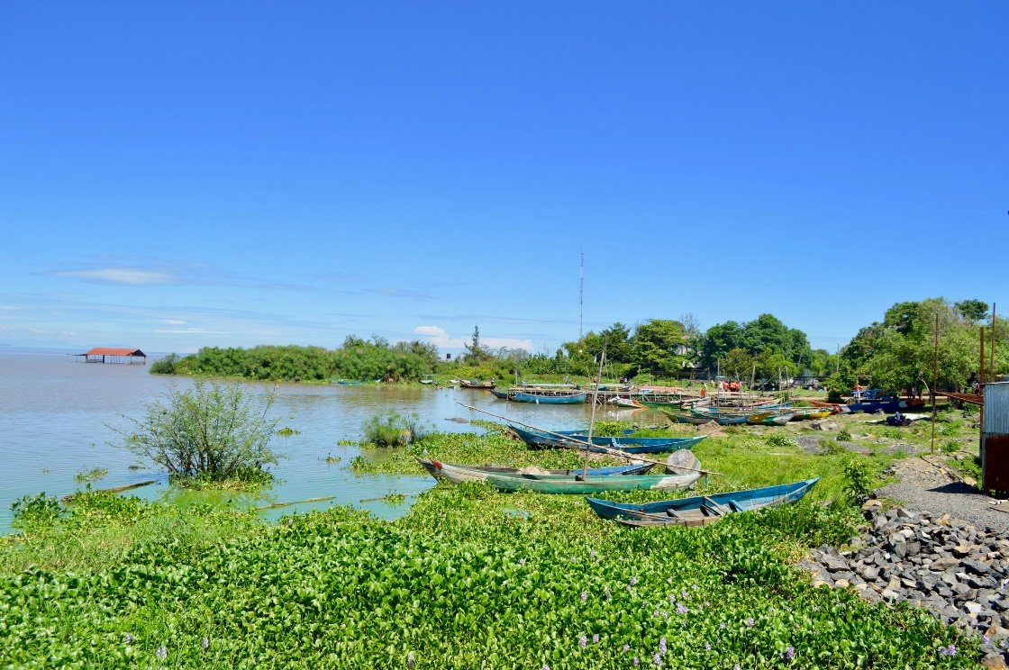
Conservation Maintains Ecosystem Services
Healthy ecosystems provide essential services such as clean water, fertile soils, climate regulation, and flood control. These services are important for sustainable development. Example: Wetland conservation around Lake Victoria helps filter water, control flooding, and provide fish breeding grounds that support fishing communities.

Slide 8
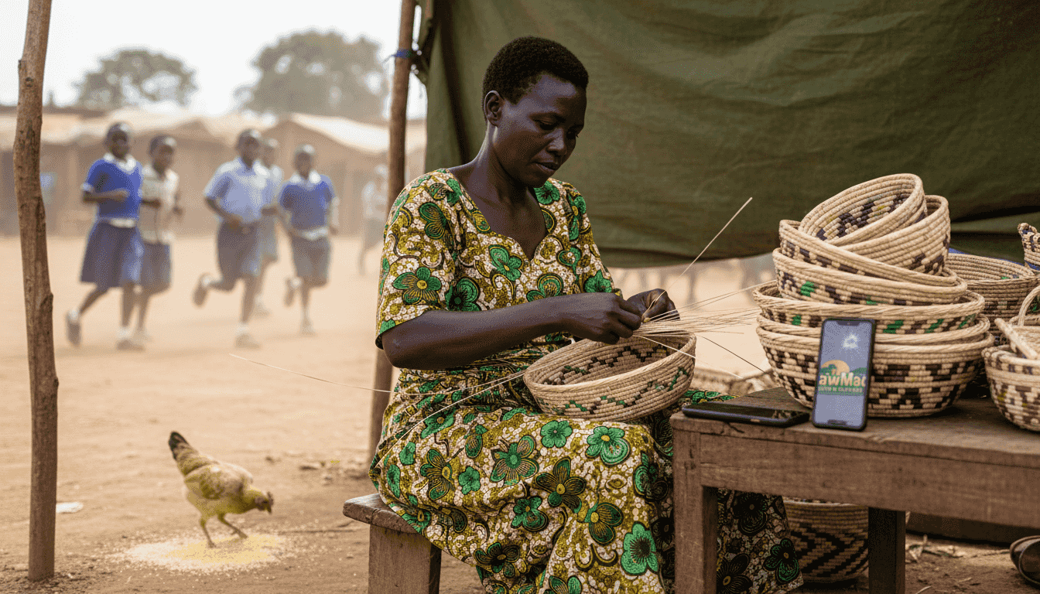
Conservation Supports Sustainable Livelihoods
Many rural communities depend directly on natural resources for their livelihoods. Conservation encourages the responsible use of these resources so that communities can continue benefiting from them in the long term.
For Example: Communities around Kibale National Park benefit from eco-tourism activities, craft selling, and employment opportunities related to conservation programs

Slide 9
Conclusion
The relationship between conservation and sustainable development is very strong because conservation provides the environmental foundation needed for long-term economic and social development. In Uganda, protecting forests, wildlife, wetlands, and biodiversity not only safeguards the environment but also supports tourism, agriculture, employment, and community livelihoods, thereby promoting sustainable development.

Slide 10
Question
“Conservation is not a barrier to development but a foundation for it.” Discuss this statement with reference to Uganda.

Slide 11
INTRODUCTION
Conservation, which involves the sustainable management and protection of natural resources such as forests, wetlands, wildlife, and water bodies, is often debated in the context of development. In Uganda, a country endowed with rich biodiversity and extensive natural resources, some argue that conservation can restrict access to land, limit resource use, and slow immediate economic growth for communities living near protected areas. Others, however, contend that conservation is essential for long-term development, as it supports tourism, agriculture, climate resilience, and social well-being

Slide 12
The following are the reasons why Conservation is not a barrier to development but a foundation for it;
Conservation Promotes Tourism and Revenue Generation
According to the Uganda Wildlife Authority (2022), gorilla tourism alone generates over $20 million annually, a portion of which is invested back into community projects including schools, health centers, and local infrastructure.

Slide 13
Supports Sustainable Agriculture and Livelihoods
Conservation enhances agricultural productivity by protecting vital ecosystems such as wetlands, forests, and riparian zones. For instance, Lake Victoria Wetlands provides water for irrigation, fish for local diets, and fertile soil for crops.

Slide 14
Provides Climate Resilience: Conserved ecosystems play a critical role in climate change adaptation. Forests like Budongo Forest Reserve and the Rwenzori Mountains National Park regulate rainfall, prevent soil erosion, and mitigate flooding.
Creates Employment and Enhances Community Development: Conservation programs in Uganda generate employment and improve social welfare. Jobs in eco-tourism, wildlife protection, and forest management offer communities a sustainable income.
Preserves Cultural and Social Values: Many Ugandan communities have sacred forests and culturally significant sites that are protected through conservation. For example, the Buganda and Busoga regions have sacred groves that are conserved alongside biodiversity..

Slide 15
However, the following are the reasons why Conservation is a barrier to development but not a foundation for it;
Restricts Land Use and Agricultural Expansion
Conservation areas often limit the availability of land for farming and settlement. For example, communities living near Kibale National Park are sometimes restricted from clearing forests for crops or grazing
Enforcement Challenges and Human Rights Concerns
Strict conservation policies can sometimes lead to forced evictions or restrictions on community rights. For example, past evictions around parks like Kibale and Bwindi displaced residents, causing social disruption

Slide 16
Limits Access to Natural Resources: In many protected areas, resource extraction such as logging, hunting, and fishing is restricted.
Human-Wildlife Conflicts: Animals from protected areas may destroy crops or threaten livestock, causing financial losses.
Potential for Inequitable Benefit Sharing: In some areas, much of the income goes to the central government or park authorities rather than villages.
Restrains Infrastructure Development: Conservation policies can limit the construction of roads, schools, or industries within or near protected areas.

Slide 17
CONCLUSION
In Uganda, conservation plays a critical role in sustainable development, serving as a foundation for economic growth, social well-being, and environmental resilience. Protected areas, forests, and wetlands generate revenue through tourism, support agriculture, provide climate adaptation benefits, and create employment opportunities for local communities. They also preserve cultural heritage and promote research, demonstrating that conservation can actively drive long-term development rather than hinder it.

